Slide 1
TOPIC: AVL Trees
GROUP 17:
SHARON NYABOKE SCT212-0193/2022
YVONNE KWAYA SCT212-0593/2021
HILLARY MWENDI SCT212-0575/2016
JOSPHAT MWAURA SCT212-0185/2019
DEBORAH WANJIKU SCT212-0132/2022
BRAMWEL SHAW SCT212-0906/2018
FR
FABRIKAM RESIDENCES

Slide 2
AVL TREES: Describe the data structure Data structures are specialized formats for organizing, managing, and storing data in a way that makes it efficient to access and modify. An AVL tree (Adelson-Velsky and Landis tree) is a type of self-balancing binary search tree. It ensures that the height of the tree remains logarithmic, which guarantees efficient operations like insertion, deletion, and search.

Slide 3
Key Properties of an AVL Tree:
Binary Search Tree Property:
The left subtree of a node contains only nodes with values less than the node.
The right subtree contains only nodes with values greater than the node.
Balance Factor:
For every node, the difference in height between the left and right subtrees (called the balance factor) must be -1, 0, or 1.
Balance factor = height(left subtree) - height(right subtree).
Self-Balancing:
If an operation (insertion or deletion) causes the balance factor to go out of range (-1 to 1), the tree performs rotations to restore balance.

Slide 4

Rotations in AVL Trees:
Rotations are used to maintain the AVL property after an insertion or deletion. We have the single rotations(LL Imbalance and RR Imbalance) and the double rotations(the LR and the RL Imbalance).
Operations in an AVL Tree:
Insertion:Similar to a binary search tree insertion but may require rotations to maintain balance.
Deletion:Remove a node like in a binary search tree, but after deletion, balance factors are checked, and rotations are performed if necessary.
Search:Follow the binary search tree search logic, which operates in O(log⁡n)O(\log n)O(logn) time due to the balanced nature of AVL trees.

Slide 5
Full ADT specification
Domain
The domain of the AVL tree includes:
A collection of unique elements from a totally ordered set (e.g., integers, strings).
Each node contains:
A key (value).
References to left and right children.
A height value (used to compute balance factors).

Slide 6
Operations
1. Create
Purpose: Initialize an empty AVL tree.
Signature: Create() → AVLTree
Precondition: None.
Postcondition: Returns an empty AVL tree with no nodes.
2. Insert
Purpose: Insert a new key into the AVL tree while maintaining balance.
Signature: Insert(tree: AVLTree, key: K) → AVLTree
Precondition: key is not already in the tree.
Postcondition: The tree includes the new key, and the AVL property is preserved.

Slide 7
3. Delete
Purpose: Remove a key from the AVL tree while maintaining balance.
Signature: Delete(tree: AVLTree, key: K) → AVLTree
Precondition: key must exist in the tree.
Postcondition: The key is removed from the tree, and the AVL property is preserved.
4. Search
Purpose: Determine if a key exists in the tree.
Signature: Search(tree: AVLTree, key: K) → Boolean
Precondition: None.
Postcondition: Returns true if the key is found, otherwise false.

Slide 8
5. FindMin
Purpose: Retrieve the smallest key in the AVL tree.
Signature: FindMin(tree: AVLTree) → K
Precondition: The tree is not empty.
Postcondition: Returns the smallest key in the tree.
6. FindMax
Purpose: Retrieve the largest key in the AVL tree.
Signature: FindMax(tree: AVLTree) → K
Precondition: The tree is not empty.
Postcondition: Returns the largest key in the tree.

Slide 9
7. Height
Purpose: Return the height of the AVL tree.
Signature: Height(tree: AVLTree) → Integer
Precondition: None.
Postcondition: Returns the height of the tree.
8. Traverse
Purpose: Visit all nodes in the tree in a specified order (e.g., in-order, pre-order, post-order).
Signature: Traverse(tree: AVLTree, order: String) → List[K]
Precondition: The tree is not empty.
Postcondition: Returns a list of keys in the specified traversal order.

Slide 10
9. RotateLeft
Purpose: Perform a left rotation to restore balance.
Signature: RotateLeft(tree: AVLTree, node: Node) → AVLTree
Precondition: The balance factor of the node is -2, and the right subtree is heavier.
Postcondition: The tree is rotated left, and the AVL property is preserved.
10. RotateRight
Purpose: Perform a right rotation to restore balance.
Signature: RotateRight(tree: AVLTree, node: Node) → AVLTree
Precondition: The balance factor of the node is +2, and the left subtree is heavier.
Postcondition: The tree is rotated right, and the AVL property is preserved.

Slide 11
11. RotateLeftRight
Purpose: Perform a left rotation followed by a right rotation to restore balance.
Signature: RotateLeftRight(tree: AVLTree, node: Node) → AVLTree
Precondition: The balance factor of the node is +2, and the left subtree's right child is heavier.
Postcondition: The tree is balanced using the left-right rotation.
12. RotateRightLeft
Purpose: Perform a right rotation followed by a left rotation to restore balance.
Signature: RotateRightLeft(tree: AVLTree, node: Node) → AVLTree
Precondition: The balance factor of the node is -2, and the right subtree's left child is heavier.
Postcondition: The tree is balanced using the right-left rotation.

Slide 12
Axioms
1. AVL Property:
For every node in the tree, |Height(left subtree) - Height(right subtree)| ≤ 1.
2. Insertion:
After inserting a key, the balance factor of all nodes remains within the range [-1, 1].
3. Deletion:
After deleting a key, the balance factor of all nodes remains within the range [-1, 1].
4. Search:
If Search(tree, key) returns true, then the key is in the tree.
5. Traversal:
The Traverse(tree, "in-order") operation produces a sorted list of all keys in the tree.

Slide 13
Choose an Application Domain
Database Indexing
AVL trees ensure O(log⁡n)O(\log n)O(logn) complexity for search, insertion, and deletion, making them ideal for maintaining indexes in databases.
They keep the data balanced, ensuring quick lookups for queries.
Use Cases:
Range queries (e.g., finding all records between two dates).
Managing primary or secondary indices in database systems.
Example:
A database for managing e-commerce orders or student academic records.

Slide 14
Implement an application
Use Case for Database Indexing
Suppose you have a database of student records, and you want to:
Index the records by student ID.
Perform efficient searches for a specific student ID.
Insert and delete student records while maintaining the balance.

Slide 15
Design
Data Structure:
Each node in the AVL tree will represent a student record, containing:
student_id (key for indexing)
name
age
grade
Operations:
Insert: Add a new student record.
Delete: Remove a student record by ID.
Search: Find a student record by ID.
Display: Traverse and print the tree in sorted order of IDs (in-order traversal).

Slide 16
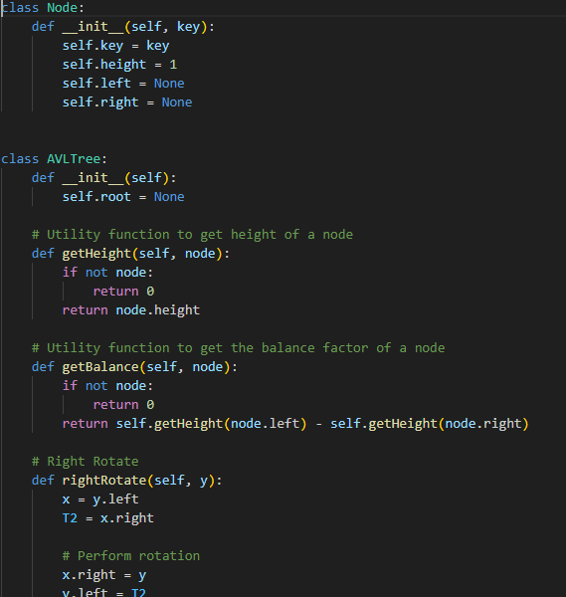
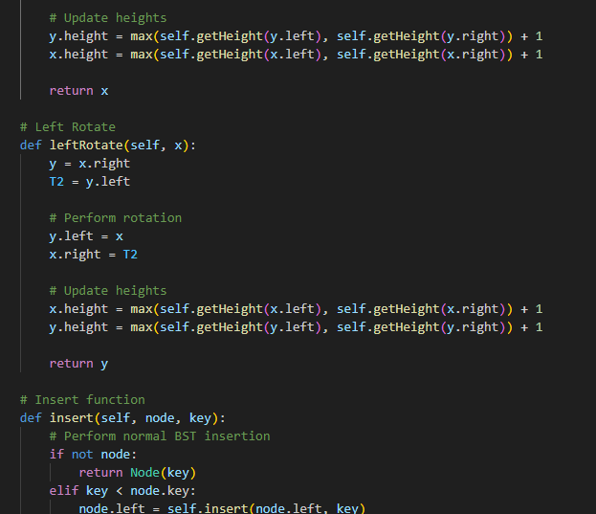

Slide 17
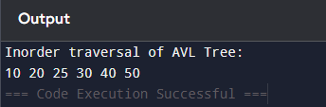

Slide 18
Features of the Code
Insertion: Adds a student record while maintaining balance.
Search: Finds a record by student ID.
Deletion: Removes a record and ensures the AVL tree remains balanced.
In-order Traversal: Prints all records in sorted order by student ID.

Slide 19
AVL TREES
ADVANTAGES AND DISADVANTAGES
Advantages
-Efficient operations: AVL trees have a guaranteed logarithmic time complexity for search, insert, and delete operations. This makes them efficient for large datasets.
-Predictable performance: AVL trees have a consistent performance and predictable time complexity.
-Fast lookup: AVL trees have efficient search operations.
-Predictable structure: AVL trees have a predictable structure that simplifies certain algorithms.
Disadvantages
-Complex implementation: AVL trees can be difficult to implement.
-Higher overhead: AVL trees require more memory and computational cost.
-Slower insertions and deletions: AVL trees have slower insertions and deletions due to frequent rotations.
-Not always necessary: AVL trees may be overkill for some applications.
AVL trees are a good choice when a dataset is large and efficient search, delete, and insert operations are needed

